Slide 1
Proposals for Federal Changes & Medicaid
Richard Whitley, Director, DHHS Stacie Weeks, JD, MPH, Administrator, DHCFP
February 26, 2025

Slide 2
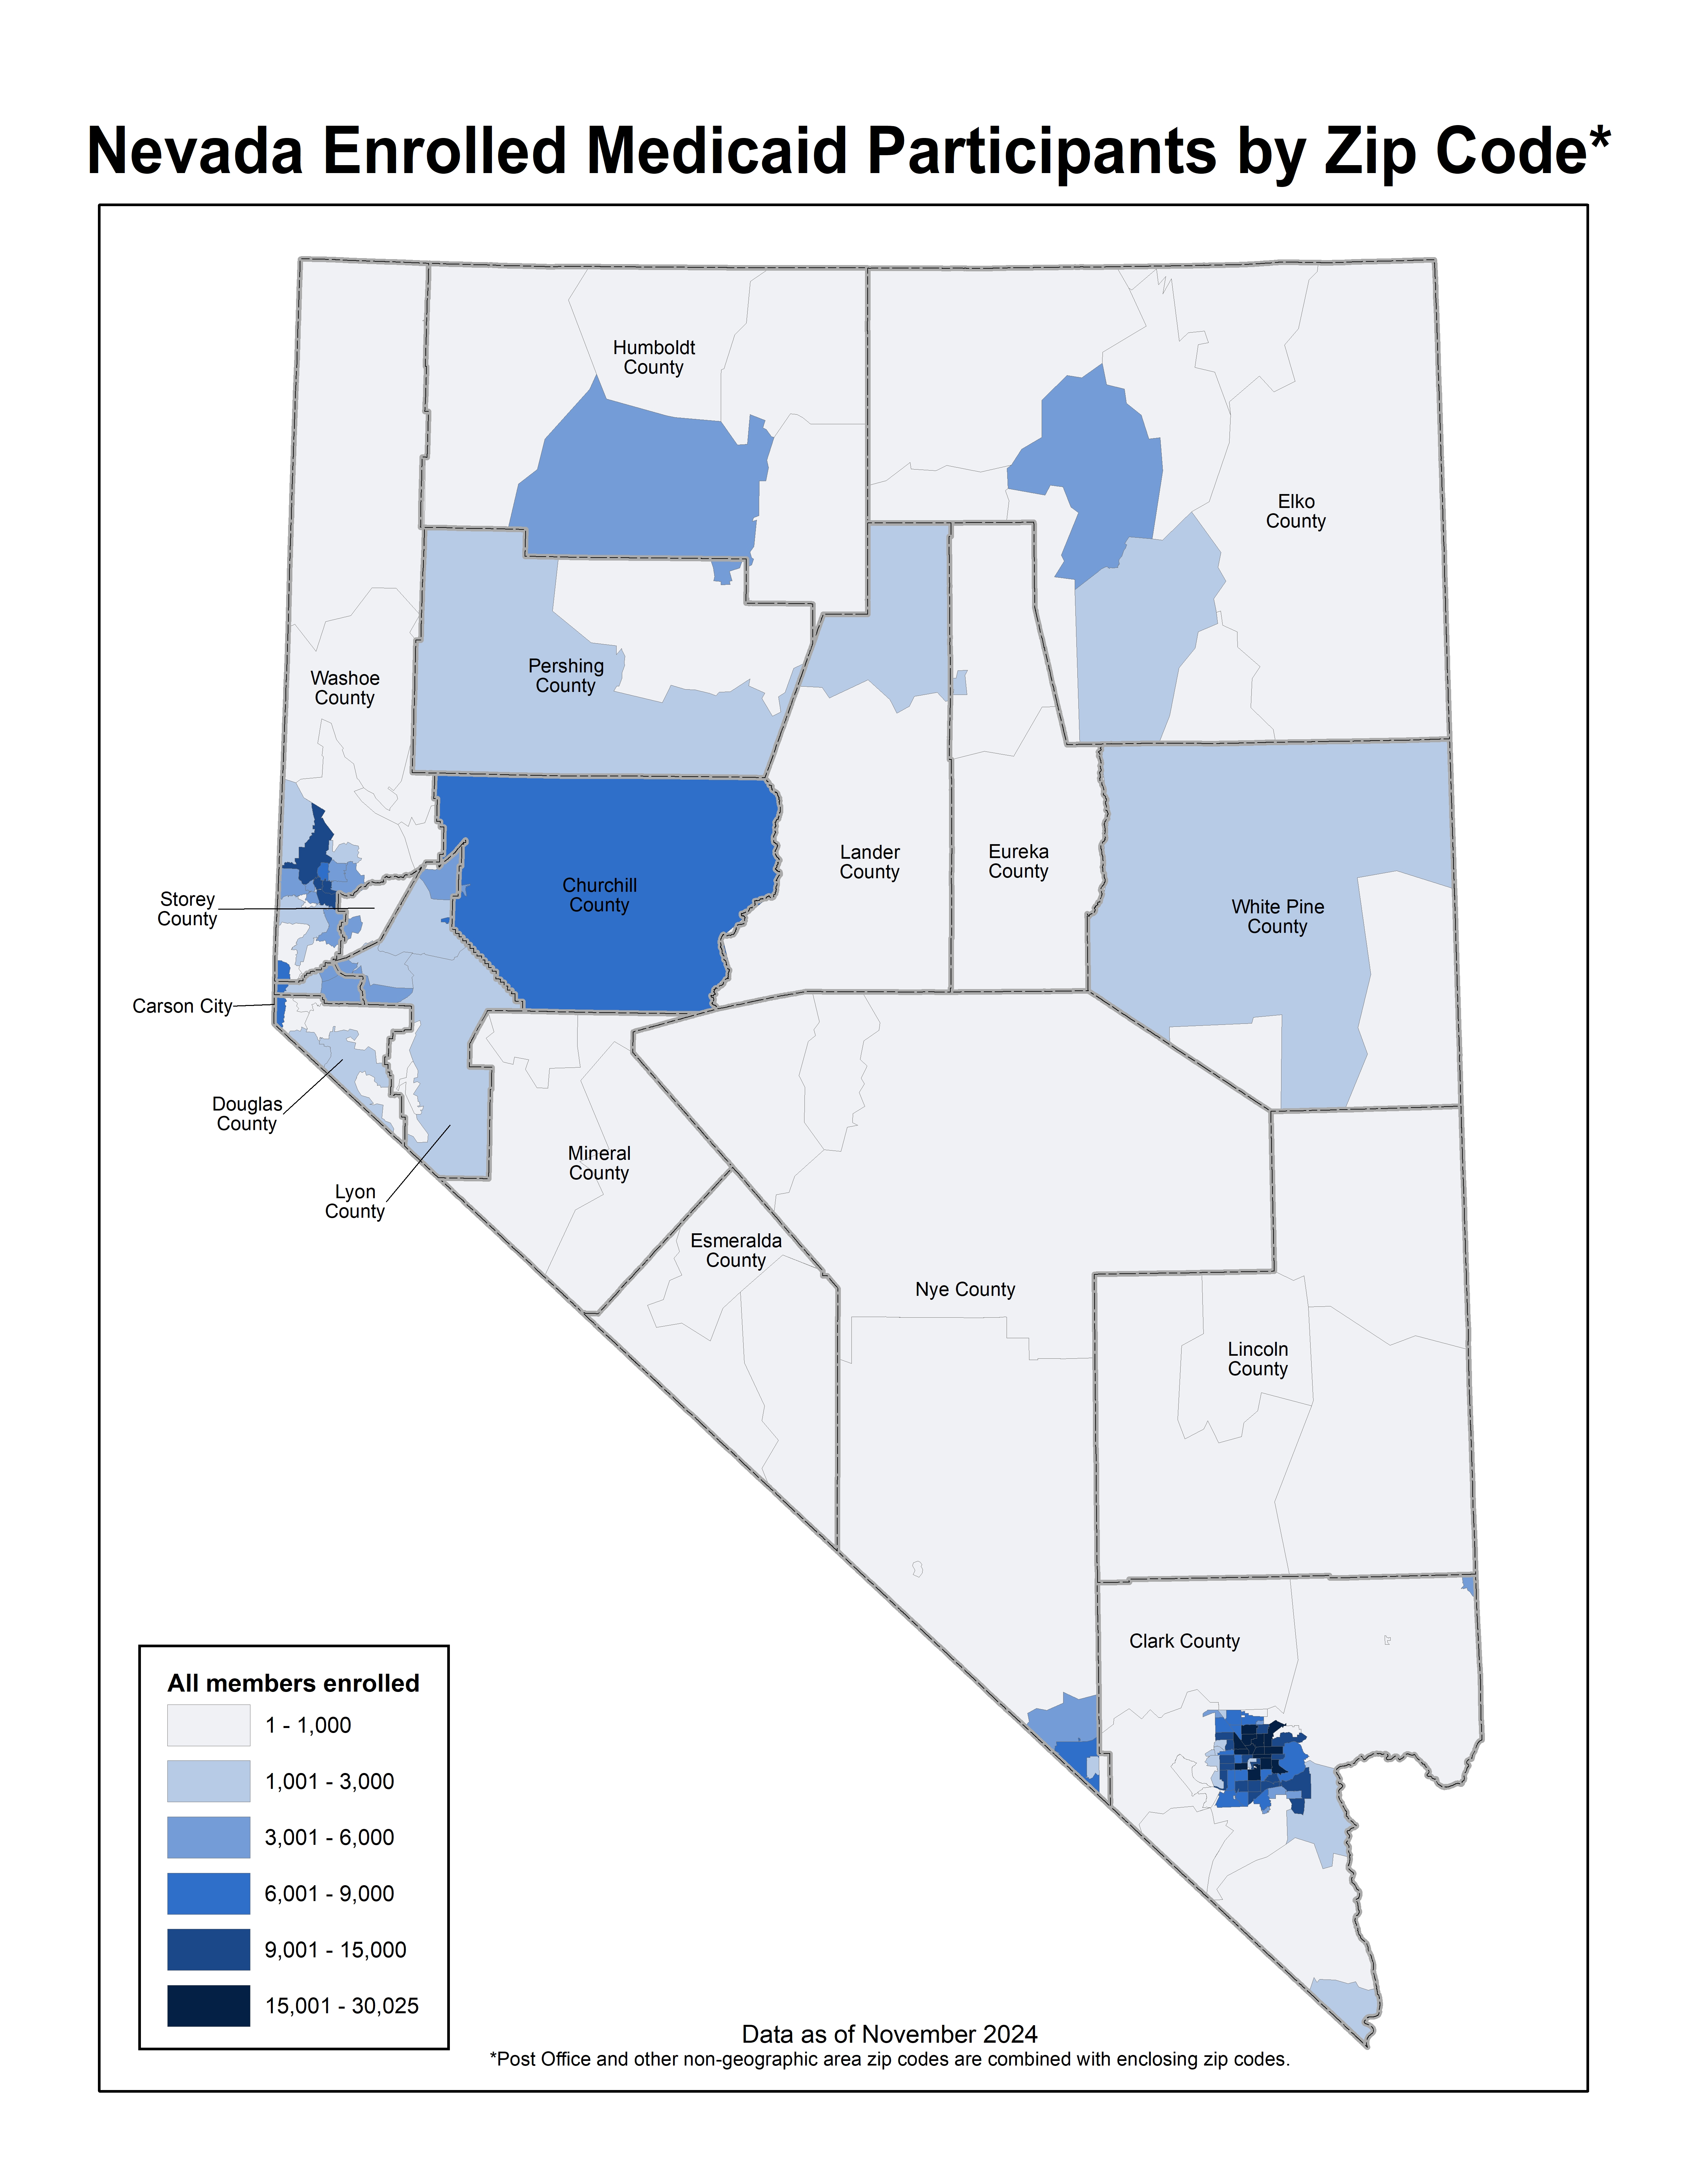
Nevada Medicaid
800,000 | Average number of people covered; 1 in 3 Nevadans; 22% growth pre-COVID
$15 billion | Biennial Spending (state and federal share)
54% | Percentage of births covered by Nevada Medicaid; 1 in 2 births
75% | Recipients served by Medicaid Managed Care Plans
40% | Recipients who are children or youth (0-18)
11% | Dually eligible for Medicare & Medicaid (85,897 individuals)
78% | Recipients who live in Clark County
66% | Percentage of adults enrolled in Medicaid who are employed
71% | Nevadans enrolled in Medicaid who are people of color
57% | Number of nursing facility residents covered by Medicaid
Sources: Office of Analytics, map based on Nevada Medicaid MMIS data warehouse, 2024; Nevada: State Facts, 2024, Kaiser Family Foundation, available here: https://www.kff.org/interactive/medicaid-state-fact-sheets/

Slide 3
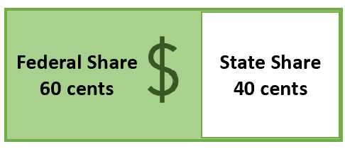
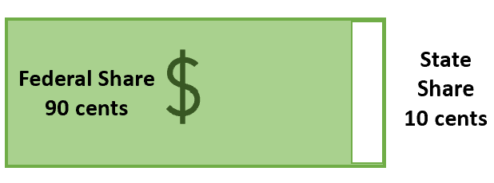
Medicaid Financing Recap
Medicaid is a state-federal partnership with federal government sharing a percentage of all costs for the program
Federal government must pay at least 50 percent of all expenditures for eligible populations and services
Traditional match is based on the Federal Medical Assistance Percentage (FMAP)
FMAP formula relies on state economic conditions (per capita income)
Traditional Medicaid Match
Expansion Medicaid Match
Source: Visual created by DHCFP using Microsoft Suite tools per end-user agreement, 2025.

Slide 4
Budgeted Funding Sources
TOTAL: $15,872,903,712
TOTAL: $18,508,137,229
Source: Visual created by DHCFP using Microsoft Suite tools per end-user agreement, 2025.

Slide 5
Potential FMAP Changes
Proposal | Estimated Impact
FMAP Equalization for Expansion: Reduction of 90% FMAP to traditional FMAP | Reduction in federal funds for Nevada of $1.858 billion over upcoming biennium. $988.9 million of which would be a State General Fund impact for the 300,000 Nevadans covered under expansion. $869 million of which would be a loss in federal funds for provider tax and supplemental payment programs
Removal of 50% minimum for FMAP for federal share | No impact.
Notes:
Per capita income in Nevada would need to increase by more than 10 percent for this change to impact Nevada. $336 million of the $869 million is the provider tax program

Slide 6
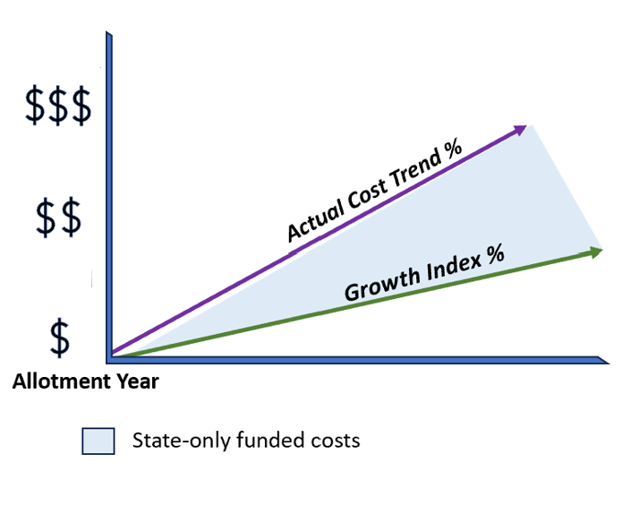
Potential Federal Funding Model Changes
Per Capita Cap Model
Federal payment to the state is capped “per capita” (or per “head” or enrollee)
States bears full risk in unexpected public health crises or pandemic
Federal funding would no longer be based on percentage of actual costs; instead – federal payment would be based on:
Initial Allotment (Base year)
Preset growth index (inflation trend factor)
Previous proposals did not relieve states of federally mandated benefits and populations
Source: Visual created by DHCFP using Microsoft Suite tools per end-user agreement, 2025.

Slide 7
Per Capita Cap Scenarios
Scenario A: Lowest Impact
Allotment Year: 2024
Growth Index: Medicare Economic Index
SFY26/27 budget impact: ($590.2 million)
Scenario B: Highest Impact
Allotment Year: 2023
Growth Index: Consumer Price Index – M
SFY26/27 budget impact: ($3.153 billion)
Note: If per capita cap is coupled with 90% FMAP equalization, then federal funding losses increase.

Slide 8
Potential Provider Tax Program Changes
Proposal: Reduction in federal tax from 6% to 4% tax which reduces revenues that are matchable by Medicaid.
Private Hospital Tax Program
Nevada’s current program includes 43 private hospitals
Proposal estimated to reduce supplemental payments for hospitals by $693 million over upcoming biennium
Reduces revenue for children’s behavioral health in Medicaid by $30 million in state revenues over upcoming biennium
If coupled with 90% FMAP equalization, these reductions would increase to $1.325 billion.
Skilled Nursing Facility Program
Nevada’s current program serves 57 skilled nursing facilities
Proposal estimated to reduce supplemental payments for skilled nursing facilities by $95.5 million over upcoming biennium.
If coupled with 90% FMAP equalization, these reductions would increase to $130.2 million.

Slide 9
Medicaid Work Requirements
Details still unknown about exempted populations or requirements
Generally, these proposals require recipients to demonstrate certain minimum number of employment hours to qualify for coverage
Based on previous proposals and review of experiences in Arkansas and Georgia, between 70,400 to 112,600 low-income working age adults’ coverage could be affected for total spending reduction of between $441 million and $705.6 million on biennium
Concerns around impact on members with mental illness or substance use, members with certain disabilities, members caring for young children or elderly relatives and those who lose employment/cannot find work

Slide 10
State Options if there are Federal Reductions
Generally, federal law limits states from cutting certain mandatory services and populations. It also limits states from reducing provider rates in a manner that negatively affects access to care.
Benefit cuts or reductions for optional services only
Eligibility reductions for optional populations only
Provider reimbursement rate reductions (access rule limits)
Generation of state revenue (new fees, taxes, etc.) or Cuts to general fund for non-Medicaid programs
Source: Visual created by DHCFP using Microsoft Suite tools per end-user agreement, 2025.

Slide 11
Mandatory v. Optional Benefits
Mandatory Benefits
Inpatient & outpatient hospital services
Early and Periodic Screening, Diagnostic and Treatment (EPSDT)
Nursing facility services
Home health services
Physician services
Rural Health Clinic services
Federally Qualified Health Center Services
Laboratory & X-ray services
Family planning services
Nurse Midwife services
Certified Pediatric & Family Nurse Practitioner services
Freestanding Birth Center services (when licensed/recognized by the state)
Transportation to medical care
Tobacco cessation for pregnant women
Optional Benefits
Prescription drugs
Clinic services
Physical, occupational, speech, respiratory therapy
Diagnostic, screening, preventive, rehab services
Podiatry services
Optometry services, Eyeglasses
Dental services
Prosthetics
Chiropractic services for children only
Other practitioner services
Private duty nursing services
Personal care services
Hospice
Case management
HCBS Waiver Services
Among others…

Slide 12
Mandatory v. Optional Eligibility Groups
Mandatory
Children and families with incomes at or below 133% of Federal Poverty Level (FPL)
Pregnant women with incomes at or below 133% FPL
Seniors (age 65 and older) who receive Medicare and are also low income
Certain parents or caretakers with very low incomes
People with disabilities
Supplemental Security Income recipients (no higher than 75% FPL)
Non-citizens for limited emergency medical assistance
Optional
Infants in families with incomes above 185% FPL
Pregnant women between 133-185% FPL
Low-income adults without children with incomes (at or below 133% FPL)
Home and Community Based Services Waiver enrollees
Katie Beckett children (higher income families with children with disabilities)
Non-citizens in their first five years of residence

Slide 13
Questions?

